Slide 1
Tommy Ramsay Action Research Project
The Conditions for Ongoing Learning

Slide 2
Project environment
At the start of this academic year, I unexpectedly lost my teaching hours on CCW Foundation due to the merging of CSM and CCW Foundation and the cutting of all staff outside of the "entitlement" time frames.
I have been running short courses with UAL and at City Academy but mostly, I have been teaching drawing and painting at Sunny Art Centre in a one-to-one capacity, helping students to build portfolios for BA applications.
At Sunny Arts, the teaching model is a lot more traditional and instructive. The teaching model I prefer and have been part of at CCW is an active learning model. Encountering this more traditional teaching environment at Sunny Arts has been an interesting and challenging experience and has helped me to further define my teaching practice.

Slide 3
My Questions
The questions I have sought to learn more about in my teaching practice through the ARP are:
Can students gain technical accuracy effectively by experimenting and looking in place of technical instruction?
Does applying NVC principles to pedagogy help students engage on a deeper level with their thinking and making?

Slide 4
Research Methods: Qualitative
My ARP is based around teaching methodology, the outcomes I associate with this are long term and focused on how students think about the "success" of their work. I have chosen to focus on using qualitative research methods:
McKayala Giradin offers the following definition for qualitative research:
"Data in qualitative research typically can’t be assessed mathematically, the data is not sets of numbers or quantifiable information. Rather, it’s collections of images, words, notes on behaviors, descriptions of emotions, and historical context. Data is collected through observations, interviews, surveys, focus groups, and secondary research."1

Slide 5
Key Influences
Paulo Freire: Pedagogy of Hope and his writing on shifting teaching from a "banking model" to "critical pedagogy" which places both the teacher and the student as learners
Auto-ethnography: Good Auto-Ethnography by Tony Adams (not the former Arsenal center back) and Frank Hermann helped to enable me to reflect more freely on the multiple layers that go into our simple teacher and student interactions
James Bury: Non-Hierarchical Learning puts forward how teachers can relate to students as collaborators allowing for "cumulative development" where a task can be more easily accomplished working together rather than by an individual
Marshall Rosenberg: Living Non-Violent Communication in Teaching and Learning
Notes:
don't read out - just list a few names and say you can take questions about the details later in the interest of time

Slide 6
Key Quotes
Paulo Freire: Knowledge emerges only through invention and re-invention, through the restless, impatient, continuing, hopeful inquiry human beings pursue in the world, with the world, and with each other 2
James Bury: In non‐hierarchical learning, it is suggested that students should be given equal responsibility for their learning outcomes. Furthermore, it is posited that increases in achievement should be measured through personal progress, where individual achievement is not judged against other students, but in relation to past performances. This approach could allow students to develop a desire for deeper understanding and gain satisfaction from perseverance and success in difficult tasks 3
Caroline Ellis on Ethnography vs Auto-Ethnography or Sunny Arts vs Tommy Ramsay: Ethnographers want to master, explain, grasp. Those may be interesting word games, but Auto-Ethnographers don’t think they’re necessarily important. Caring and empathising is for us what abstracting and controlling is for them. We want to dwell in the flux of lived experience; they want to appropriate lived experience for the purpose of abstracting something they call knowledge or theory 4
Notes:
Only read out one....
2

Slide 7
My Intervention
Warm-up experimental drawing exercises at the start of every lesson with the aim of offering students new technical ways of working, allowed students to be surprised by what they made, opened their perceptions on a need for control and shifted ideas away from representational accuracy as being the marker of a good or bad drawing.
I applied NVC communication in my conversations with students. Moving away from power over to a power share and away from verbal feedback on student work being good or bad onto asking questions which help students to come to their own conclusions.
Marshall Rosenberg says "Power-Over leads to punishment and violence. Power-With leads to compassion and understanding, and to learning motivated by reverence for life rather than fear, guilt, shame, or anger.” 5
Notes:
FILLING IN AND LOOKING:
The difference between looking and filling in is a key part to the methodology behind what I am offering to my students. Some of the teaching has been based around drawing and painting with the still life genre (I am teaching at a traditional Art Centre!). Within this, students still life set ups include familiar objects such as organic objects as well as things such as glasses, bottles etc. These are all objects that we "know" and are familiar with. I wanted students to become conscious of when they were drawing what they knew the object to look like within their mind, I referred to this as filing in. What I hoped was that helping students to be aware of this, would allow for them to reconnect with the objects and get back to looking at the object and drawing what they saw. No two apples are the same. And more importantly, this places a responsibility on them to connect with what they are making and to be in charge of their own work.
..X. With the aim of helping students in their work to stop filling in space and start looking at the objects they were making from to allow them a deeper connection to their work.

Slide 8
Intervention 1: Experimental Drawings by Students
Task 1: Blind drawing...
Task 2: Drawing without looking down at the page...
Task 3: Observational drawing...
Task 4: Drawing from memory.
Notes:
Within these exercises, students were given the following prompts:
Drawing 1: Feel the object in your hand, try not to guess what it is, but try to connect with how the object feels e.g. shape, texture, size). How can you describe your experience of this through line and mark making? This exercise is about freeing up your relationship with drawing and recording the experience of how your object feels, allowing for senses other than your visual perception to take over.
Drawing 2: Please hold your object above your eye line and draw your object without looking down at the page. You are now experiencing the object through looking and recording the experience of looking through your mark making, but you are not censoring your drawing by looking down at your drawing.
Drawing 3: Draw your object in as much detail as you can. You could think about being a microscopic insect like an ant moving and travelling over the body of the object. How much detail can you describe? What details interest you?
Drawing 4: You have been looking at your object closely and observing it. You will have recorded its appearance in your mind’s eye. Now turn your back on your object and draw it from memory. Consider the previous tasks to guide you:
How did the object feel in your hand when you could not see it? How did it feel when your eye moved over the object in great detail?

Slide 9
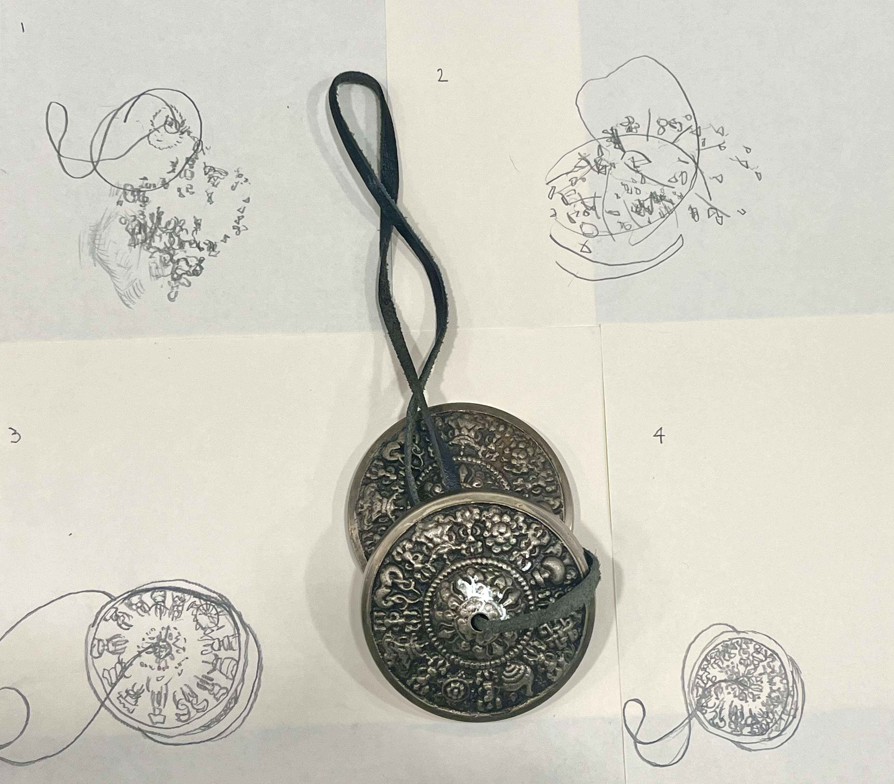
Notes:
So left to right, drawing 1 is the blind drawing, drawing 2 is the holding the object above the eye line and not looking down, drawing 3 is a traditional, observational drawing and image 4 is a drawing from memory.

Slide 10
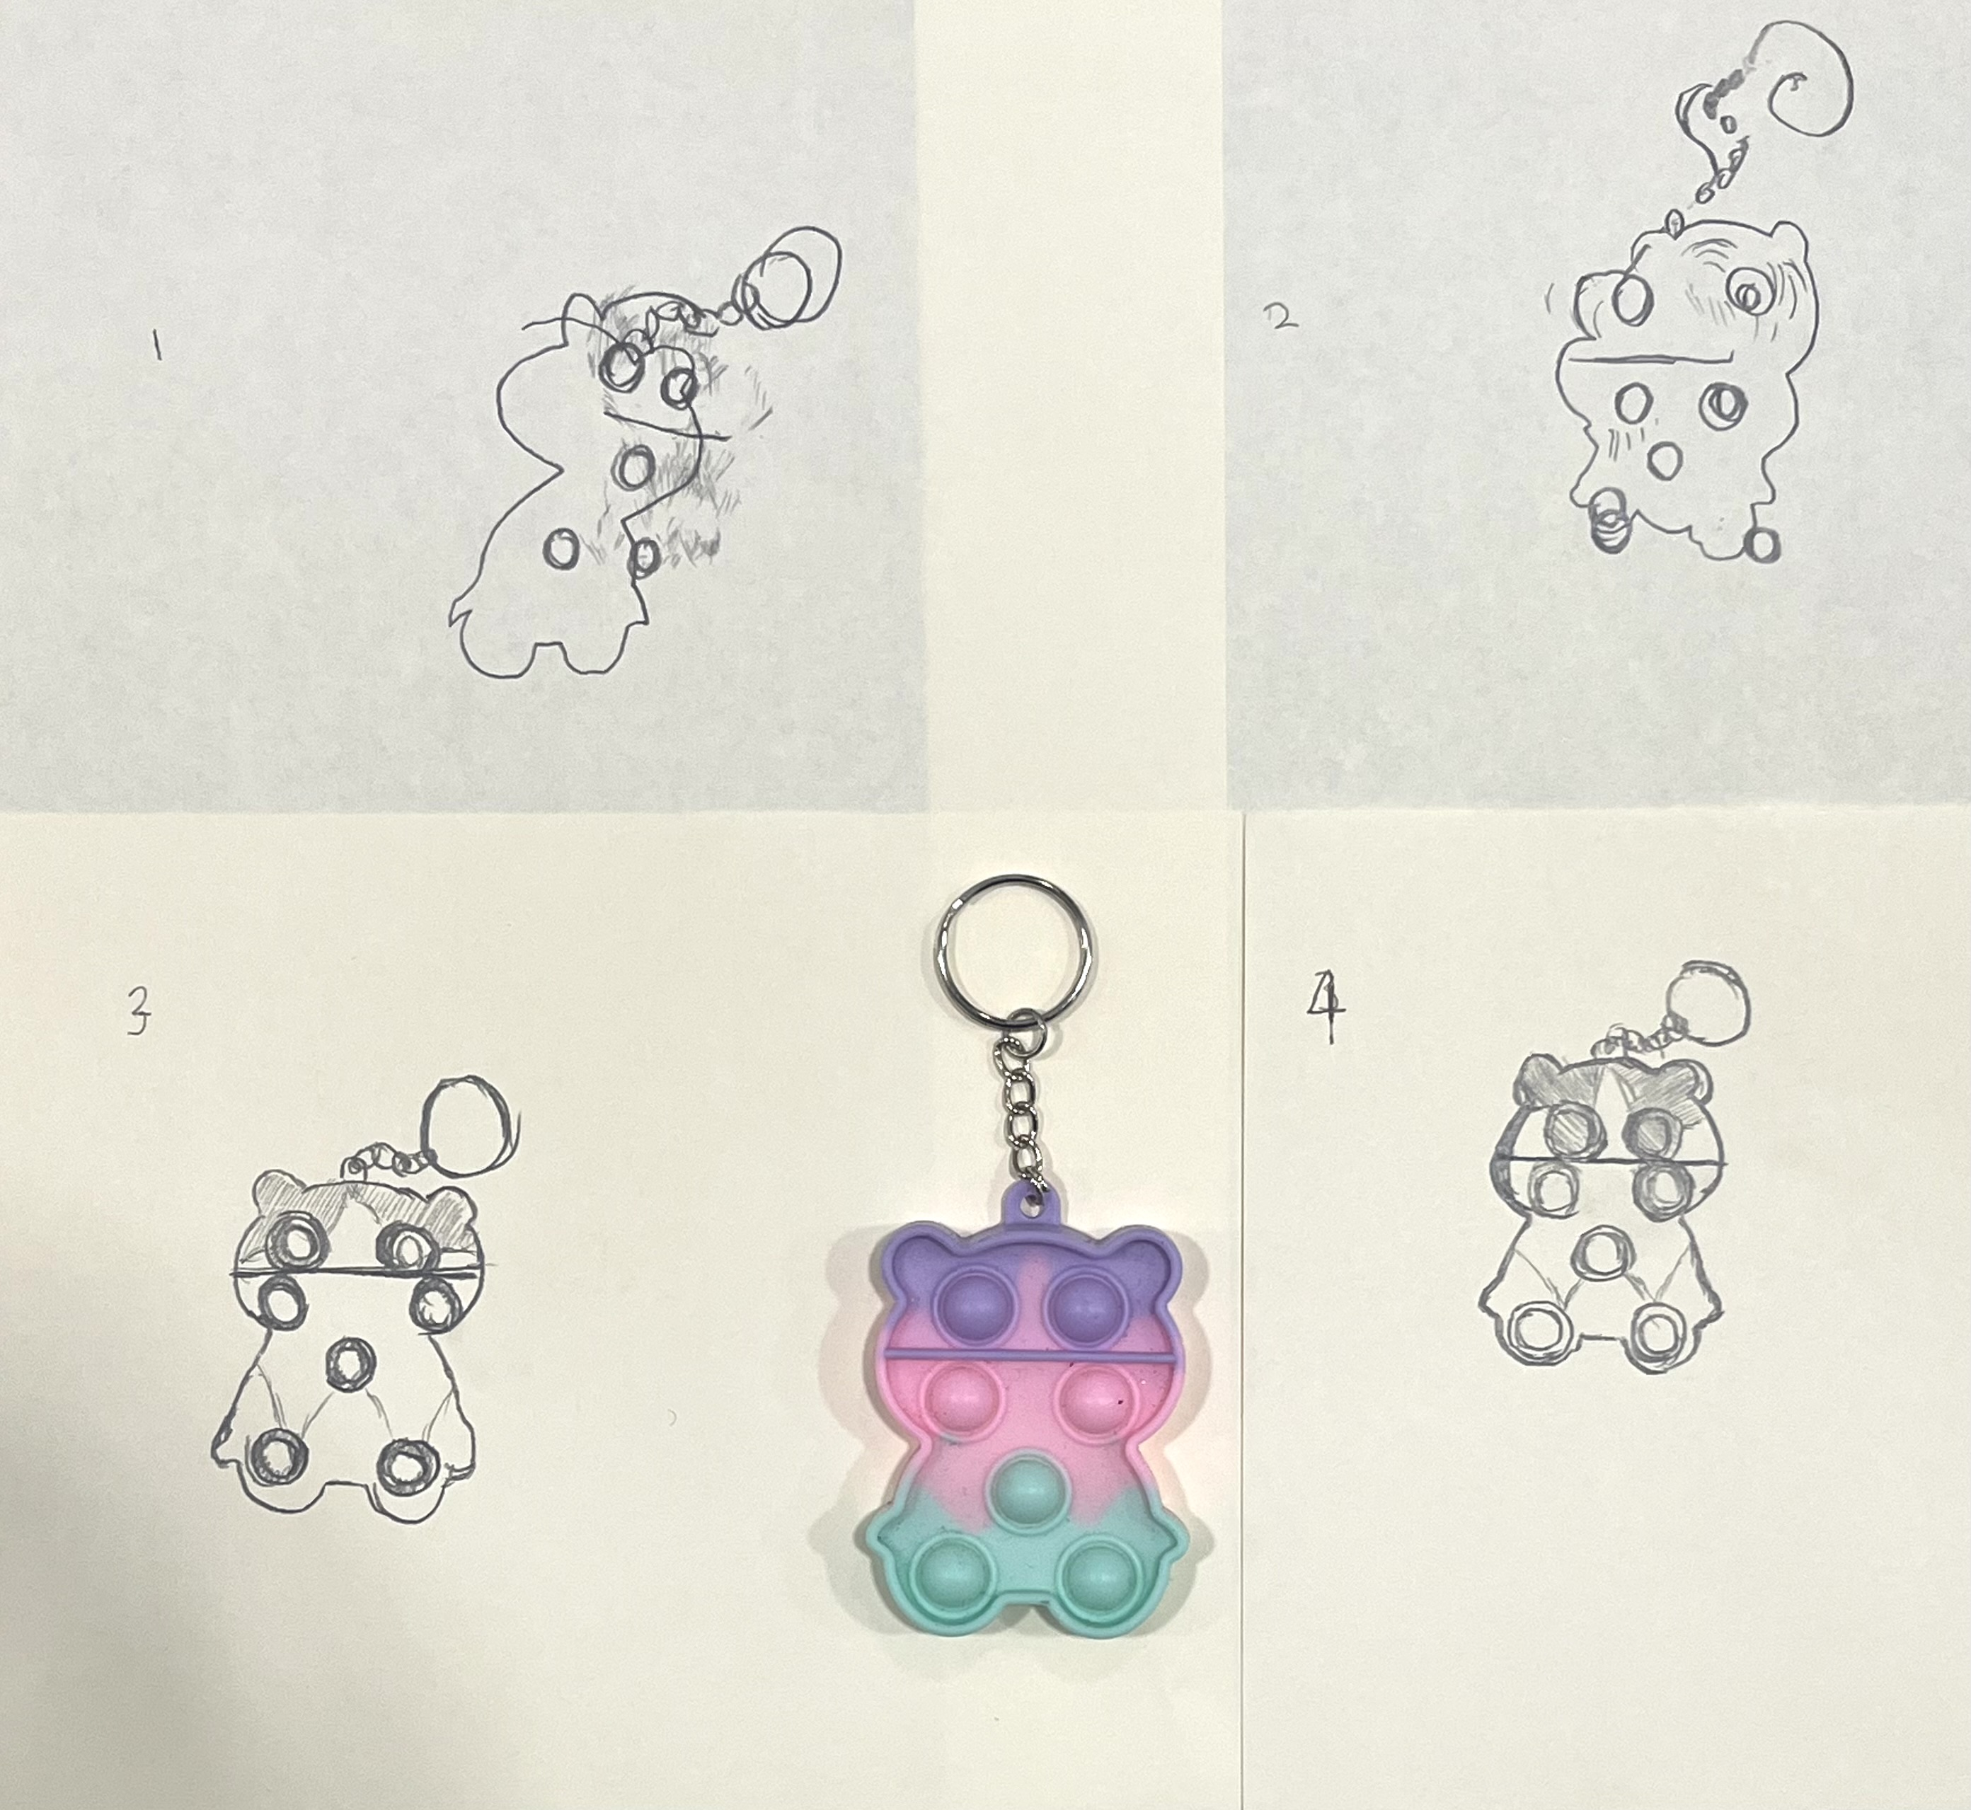

Slide 11
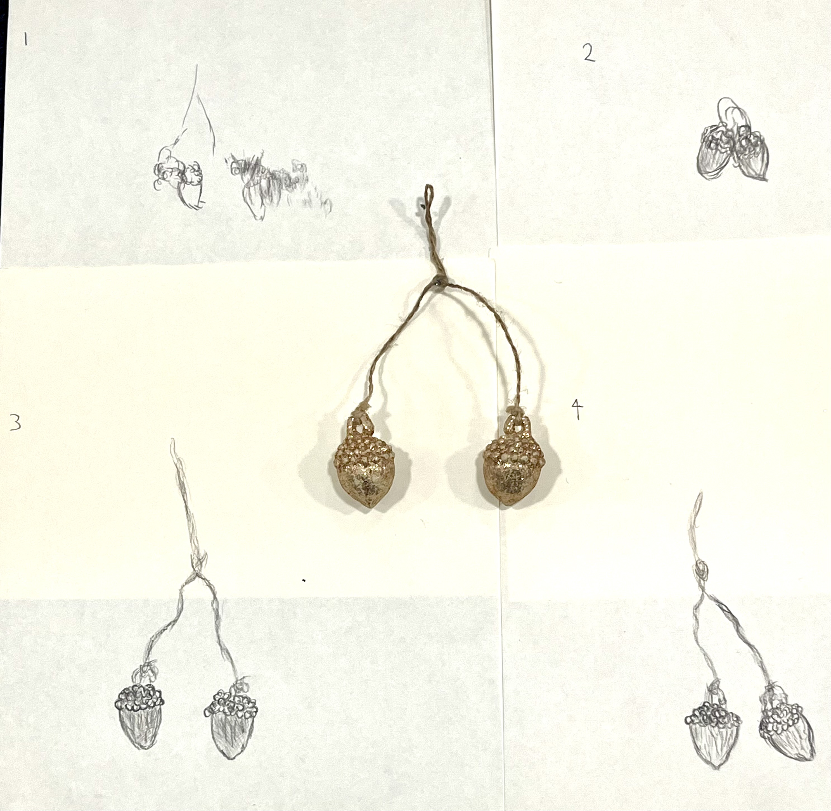

Slide 12
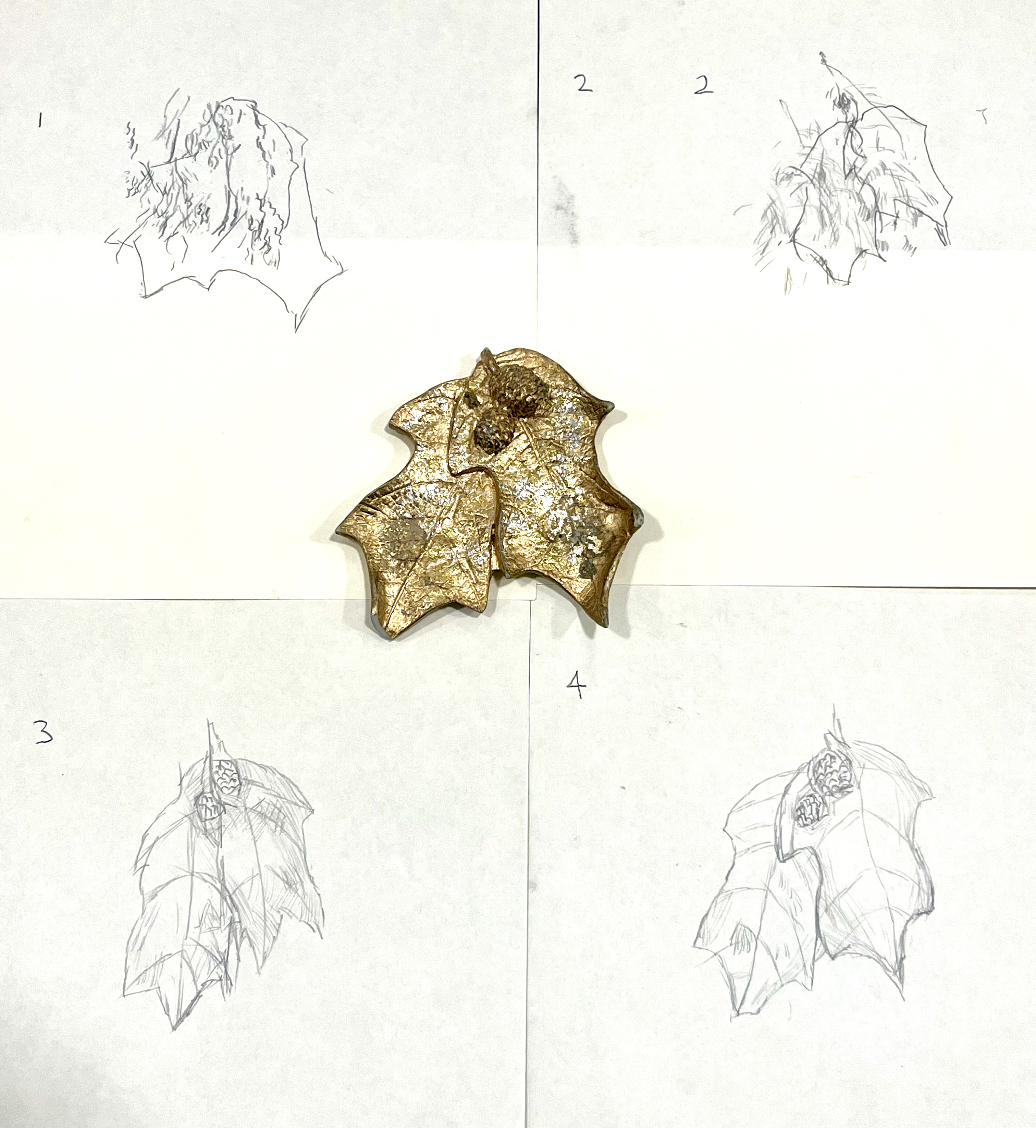

Slide 13
Student "Y" Likert Scale responses to experimental drawings
 | Rating from 1 – 5 with 1 being strongly disagree and 5 being strongly agree | 1 | 2 | 3 | 4 | 5
A | I have found the experimental drawings to be a new way of working? |  |  |  |  | X
B | I understand the thinking behind why we are doing the experimental drawings? |  |  |  |  | X
C | I have found the experimental drawings to be generative in new ways of thinking about making my work? |  |  |  |  | X
D | I have found the techniques used in the experimental drawings to be useful in making my work? |  |  |  | X
E | This way of working has opened new things for my work? |  |  |  |  | X
Notes:
Student Y anecdote: first lesson we had together, we made a simple Magritte inspired still life with an apple, a glass and chose a sky as the background. I said of you go, after a moment, student Y asked me: "how do I paint the sky?" ... I said well what do you mean, here is some paint, start mixing and putting it down! Student Y was used to being shown techniques on how to do things and not used to being asked to take the lead in their own learning. We have now spent about 120 hours working together and Student Y is much more comfortable working without technical instruction, I even pursuaded them to use glitter in the last painting...

Slide 14
Intervention 2: NVC
The core fundamentals of teaching and learning through NVC are:
Helping students connect with their intrinsic motivations for learning, rather than extrinsic motivators such as reward or punishment.
I applied NVC communication in my conversations with students. For example, an NVC conversation with a student could go as follows:
Observation: I noticed that you stopped working on this section of your drawing
Feeling: are you feeling frustrated
Need: because you would like to have figured out a solution by now?
Request: would you like some help with that problem?
This way of communicating shows empathy and asks the student if they would like help.

Slide 15
Student "B" Likert Scale responses to NVC communication
 | Rating from 1 – 5 with 1 being strongly disagree and 5 being strongly agree | 1 | 2 | 3 | 4 | 5
A | I feel empathetically supported in my studies? |  |  |  |  | X
B | I feel that my tutor made observations rather than judgements when discussing my work? |  |  |  | X
C | I feel more connected to my work by being asked how I feel about my work? |  |  |  |  | X
D | I feel more motivated by being asked what I feel about my work rather than being told by my tutor? |  |  |  |  | X
E | This way of communicating has opened new things for my work? |  |  |  | X

Slide 16
Student "J" Feedback via email interview
T: How did you find the experimental drawing warmups at the start of sessions? Did they influence the observational drawing that you made afterwards?
J: The first session of experimental drawings was challenging, but by the next session I found them to be a fun and interesting experience. I often choose to use the experimental drawing techniques in my paintings as well if I am a little stuck or unsure how to make something.
T: How do you feel being asked to learn by looking?
J: It has helped me to feel connected to what I was making, and I was able to work for a much longer time on each work. Being asked to look more meant there was more to work with in each still life painting and drawing that I made which I really enjoyed.
T: Looking at your drawings and your work, how do you feel your work has changed with this way of looking and making?
J: I feel much more confident with my work, and in these sessions, I have made my best work so far. I think this is because I am thinking about how to describe each object that I make rather than judging how well I am copying it. I enjoy working this way too and I feel more responsible for my own work!

Slide 17
Evaluation or Observations
The experimental drawings have enabled students to feel more comfortable with their work being less representationally accurate. My selection of the objects themselves is important, the objects must have some ambiguity to them when held blindly e.g. not be a pinecone. Students have always preferred the 3 experimental drawings where they have the limitations in place and have often used these in their other work.
The implications of the NVC intervention are more tangential. I feel that from the conversations that I have with students and the feedback that there has been a clear shift in how we communicate. These shifts have allowed students Rtheir own feelings when observing their work.
The combination of the technical and cognitive shifts from the experimental drawings has worked alongside the NVC communication to help students to work with more self-awareness and to make work with more engagement and confidence.
Notes:
In fact, knowing my students and my subject depends heavily on self-knowledge. When I do not know myself, I cannot know who my students are. I will see them through a glass darkly, in the shadows of my unexamined life—and when I cannot see them clearly I cannot teach them well. When I do not know myself, I cannot know my subject—not at the deepest levels of embodied, personal meaning.

Slide 18
Teaching Positionality post PGCERT
Our education system historically is based on a form of retributive justice. Where we are judged as right or wrong, good or bad, creating a system where we feel that when we are in line with these rules, we deserve to be rewarded or punished accordingly. This kind of system is a basis for violence.
This system makes connection and empathy less within our reach. It creates a system where we are in competition with one another, instead of working together and enjoying contributing to each other's goals and journeys. It makes it harder to access what is alive in each of us. It is a system that makes it harder to have shared values.
It stops us developing a connection to our feelings. Feelings are an integral part of what makes us human. Developing a literacy to access these feelings allows us to develop who we are, which is what I want to help students to access.
I believe that connection is the key, when I am grounded or connected with myself, I can connect to the subject I am teaching, with my students, so that students can learn to weave a world for themselves.

Slide 19
Bibliography
Girardin,McKayla. What is Qualitive Research? https://www.theforage.com/blog/skills/what-is-qualitative-research, accessed on 20/12/2024
Freire, Paulo. (1970) Pedagogy of the Oppressed, New York: Bloomsbury Academic. (eBook in library)
Bury, James. Non‐Hierarchical Learning: Sharing Knowledge, Power and Outcomes, https://core.ac.uk/download/pdf/153536466.pdf, accessed on 27/12/2024
Carolyn S. Ellis and Arthur P. Bochner, Analyzing Analytic Autoethnography An Autopsy, Journal of Contemporary Ethnography, Volume 35 Number 4, August 2006
Rosenberg, Marshall. Non-Violent Communication Training: Authority: Respect vs Fear, https://open.spotify.com/show/3jPpnalv97b9ky9BB5DCAA, 3 February 2020, accessed on: 10 November

Slide 20
References
Adams, Tony E., Carolyn Ellis, and Stacy Holman Jones. ‘Autoethnography’. In The International Encyclopedia of Communication Research Methods, edited by Jörg Matthes, Christine S. Davis, and Robert F. Potter, 1st ed., 1–11. Wiley, 2017. https://doi.org/10.1002/9781118901731.iecrm0011.
Ahmed, Sara. Living a Feminist Life. Durham: Duke University Press, 2017.
Aziz, Razia, Feminism and the challenge of racism: Deviance or Difference. Black British Feminism: A Reader: accessed from on 7 December 2024: https://books.google.co.uk/booksid=GdSqaz6NBMIC&pg=PA70&source=gbs_toc_r&cad=4#v=onepage&q&f=false
Baumard, Phillipe, Tacit knowledge in organizations (London, Sage Publications), 1999
Bury, James. Non‐Hierarchical Learning: Sharing Knowledge, Power and Outcomes, https://core.ac.uk/download/pdf/153536466.pdf, accessed on 27/12/2024
Barrow, Mark. ‘Assessment and Student Transformation: Linking Character and Intellect’. Studies in Higher Education 31, no. 3 (June 2006): 357–72. https://doi.org/10.1080/03075070600680869.
Boud, D. Sustainable assessment: rethinking assessment for the learning society, Studies in Continuing Education, 2000
Bullen, Duncan, Jane Fox, and Philippa Lyon. ‘Practice-Infused Drawing Research: “Being Present” and “Making Present”’. Drawing: Research, Theory, Practice 2, no. 1 (1 April 2016): 129–42. https://doi.org/10.1386/drtp.2.1.129_1
Full list of references available here: Reference List

